Slide 1
Modal Analysis: PCB under 5k/10k g’s
EMCH-428, PCB Ballistic Test Stand Team
Christopher JONES, Anthony Molinaro, Caleb Gunter, Stephan Jette

Slide 2
Physical Properties
The table below illustrates the physical properties required by Creo Simulate in order to generate the mode shapes in the following slides.
PROPERTY | VALUE | UNITS
Poisson’s Ratio | 1.360000e-01 | None
Young’s Modulus | 2.400000e+01 | GPa
Thermal Expansion Coeff. | 1.400000e+01 | /K
Tensile Yield Stress | 3.100000e+02 | MPa
Tensile Ultimate Stress | 3.000000e+02 (Assumed, brittle) | MPa
Mass Density | 1.850000e+00 | g/cm^3
Sourced from: https://www.edcorusa.com/pcb

Slide 3
Mode Shape Simulations
Note: The following Mode shapes are identical and have identical natural frequencies regardless of 5000/10000g loadings.

Slide 4
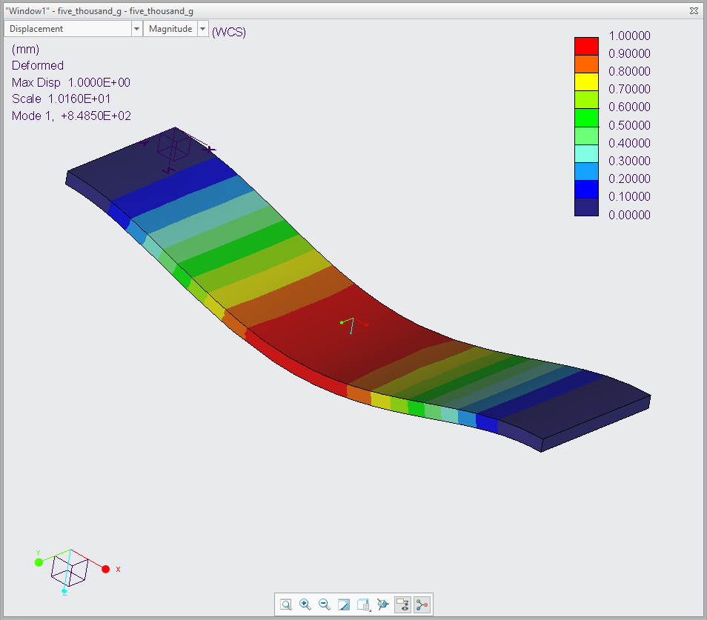
5000/10000G, first mode shape
First mode shape generated under 5000 or 10000gs.
Mode 1 occurs at: 8.4850E+02 Hz

Slide 5
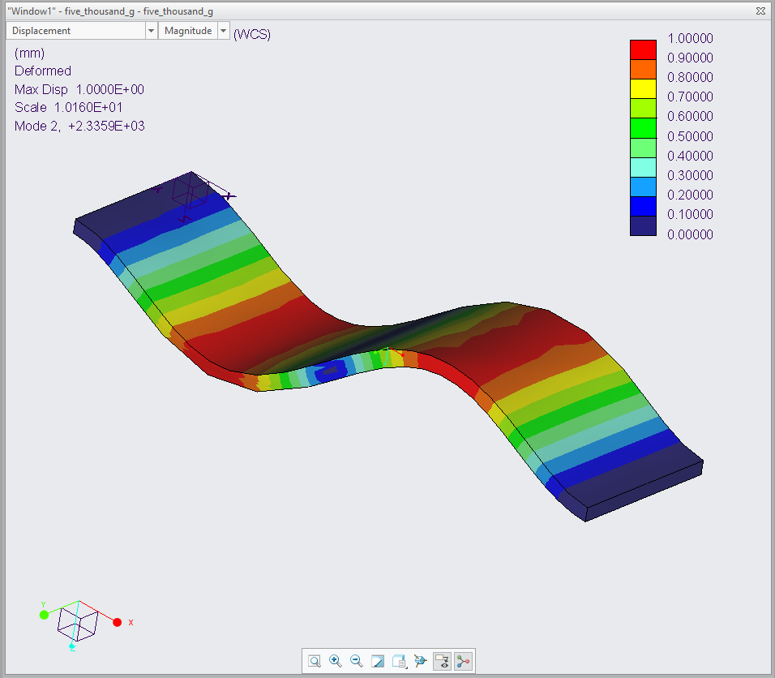
5000/10000G, Second mode shape
Second mode shape generated under 5000 or 10000gs.
Mode 2 occurs at: 2.3359E+03 Hz

Slide 6
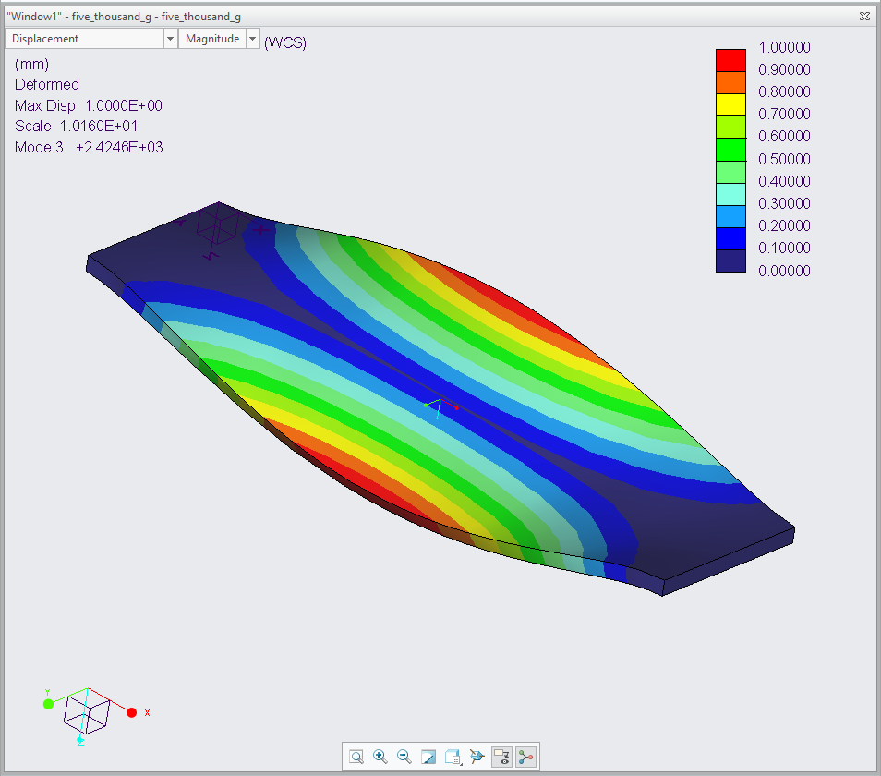
5000/10000G, third mode shape
Third mode shape generated under 5000 or 10000gs.
Mode 3 occurs at: 2.4246E+03 Hz

Slide 7
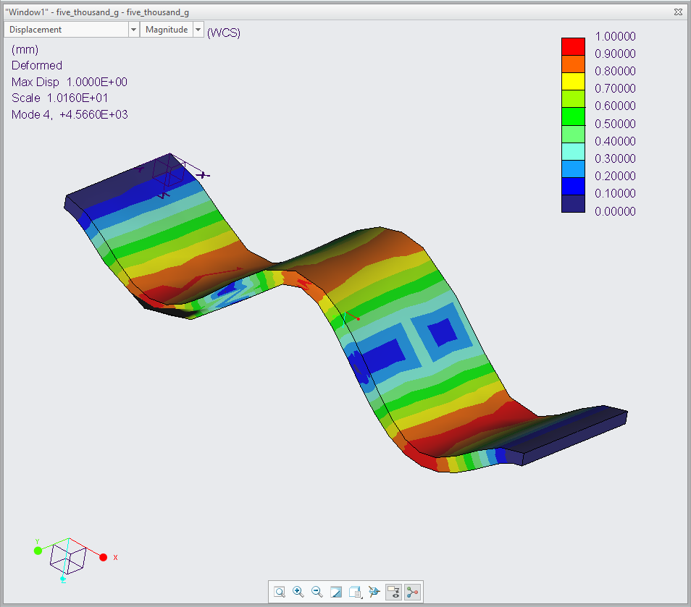
5000/10000G, Fourth mode shape
Fourth mode shape generated under 5000 or 10000gs.
Mode 4 occurs at: 4.5660E+03 Hz

Slide 8
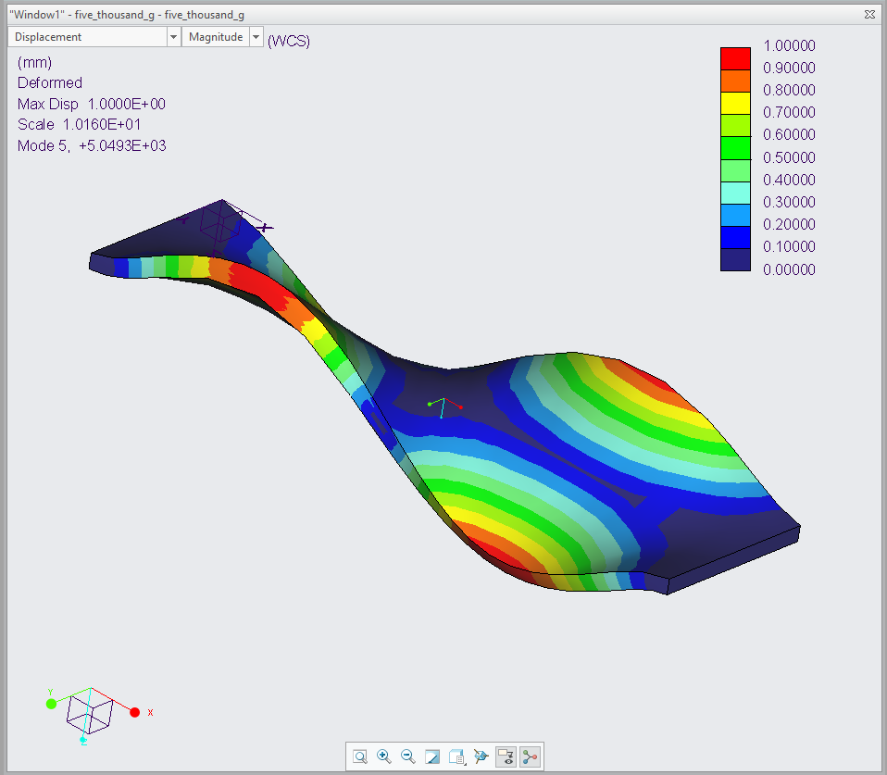
5000/10000G, fifth mode shape
Fifth mode shape generated under 5000 or 10000gs.
Mode 5 occurs at: 5.0493E+03 Hz

Slide 9
Thank you
-PCB Ballistic Test Stand Team

